Slide 1



Ultrasonic Sensor based Obstacle Detection and Avoidance WMR
ECE-C2, GROUP – 5
Mr. Bibhu asish panda (22bece02)
Miss M. Flora (22becd60)
Mr. Ommprasad Sundaray (22beid39)
Mr. AyushH Raj (22becg34)
Miss Bidisha Sonusaumya (22bech56)
GUIDED BY :
Dr. Manoranjan Praharaj
(Assistant Professor)
Department of Electronics and Communication Engineering,
Silicon University, Silicon Hills, Patia,
Bhubaneswar-751024 (Odisha)

Slide 2

CONTENTS
Introduction
Literature Survey
Problem Statement
Proposed Techniques
Results Analysis
Conclusions & Future Scope
1

Slide 3
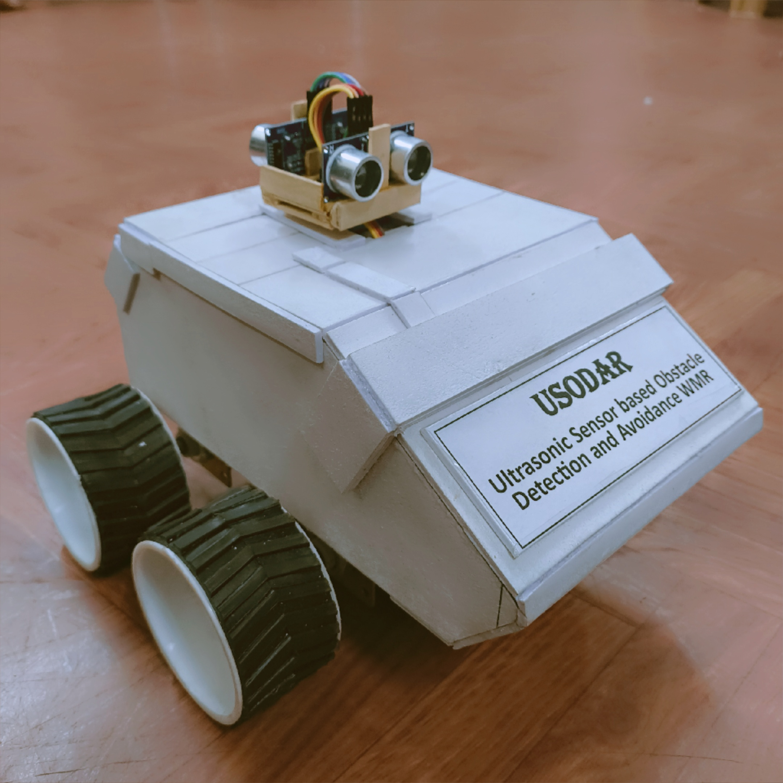
INTRODUCTION
Autonomous mobile robots rely on smart sensors and control systems for navigation.
Obstacle detection is crucial to ensure safe and collision-free movement.
The proposed robot uses an ESP-32 microcontroller and ultrasonic sensors for real-time obstacle detection and avoidance.
L298N motor drivers control the DC motors for precise movement.
Development was carried out using the Arduino IDE for efficient programming.
The system is built with low-cost, widely available components to ensure replicability.
Testing on smooth surfaces demonstrated strong reliability and adaptability.
2

Slide 4
LITERATURE SURVEY
Borenstein and Koren (1988) implemented a robot using a discrete-time sliding mode controller that switched from global to local trajectories when obstacles appeared.
Irawan et al. (2021) designed an ultrasonic-based robot with directional obstacle avoidance and achieved 87.5% accuracy.
Ciubucciu et al. (2016) validated a sliding-mode control algorithm for obstacle avoidance through simulations and real-time testing.
Aung and Oo (2018) used PID control and ultrasonic sensors for accurate path tracking and obstacle distance maintenance.
Agbeyangi et al. (2020) addressed fast robot behavior and local minimum traps using a real-time navigation algorithm.
Mothe et al. (2020) developed a support robot for the disabled, highlighting ultrasonic sensor limitations due to wave scattering.
Badal et al. (1994) applied ultrasonic sensors in a floor-cleaning robot with a zig-zag movement, unlike the simpler system proposed here.
3

Slide 5
PROBLEM STATEMENT
Autonomous Navigation in Public Spaces
Problem: Robots face difficulty maneuvering through crowded areas like malls or airports.
Solution: Deploy WMRs with dynamic obstacle avoidance for safe and efficient public navigation.
Automated Agricultural Monitoring
Problem: Manual inspection of large fields is slow and inefficient.
Solution: Use WMRs to autonomously scan farmland, avoid obstacles, and detect terrain issues.
Smart Industrial Transport
Problem: Factory floors are cluttered and hazardous for mobile robots.
Solution: Implement WMRs for safe, collision-free transport of materials in industrial settings.
Indoor Package Delivery
Problem: Autonomous delivery in offices or hospitals risks disruption or damage.
Solution: Develop WMRs to navigate hallways and rooms, delivering packages safely.
4

Slide 6
Autonomous Firefighting Robot
Problem: Fires in inaccessible zones pose risks for human firefighters.
Solution: Equip WMRs with temperature sensors and extinguishers for safe, autonomous fire response.
Security Patrol in Restricted Zones
Problem: Manual patrols are labor-intensive and error-prone.
Solution: Use WMRs to autonomously patrol and monitor secured areas while avoiding obstacles.
Search and Rescue Operations
Problem: Navigating collapsed or hazardous environments endangers rescue teams.
Solution: Deploy obstacle-avoiding WMRs to explore and assist in rescue missions safely.
Military Reconnaissance
Problem: Human presence in hostile zones is high-risk.
Solution: Utilize rugged WMRs for autonomous navigation and surveillance in combat zones.
5

Slide 7
Assistive Robotics for Elderly/Disabled
Problem: Mobility support in obstacle-prone homes is challenging.
Solution: Create WMRs that assist with navigation and daily activities in indoor environments.
Autonomous Robotic Cleaning
Problem: Standard robotic vacuums fail in complex layouts.
Solution: Use WMRs with advanced obstacle avoidance for thorough, autonomous cleaning.
Smart Parking Management
Problem: Inefficient vehicle movement leads to congestion in parking lots.
Solution: Develop WMRs that guide vehicles to free spaces and improve parking flow.
Automated Shopping Cart System
Problem: Traditional carts are hard to manage in crowded stores.
Solution: Introduce WMR-based carts that autonomously follow customers and return to base.
6

Slide 8
PROPOSED TECHNIQUES
Step 1: Initialization
Robot starts moving forward.
Both DC motors engaged.
Servo motors at 0°: Sensor-1 → Front
Sensor-2 → Back
Step 2: Obstacle Detection
Sensor(1) scans ahead continuously.
If obstacle < 30 cm:
→ Robot halts
→ Servo rotates to 90° (Sensors face sides)
Side Evaluation:
→ Obstacle Right + Left Clear → Turn Left
→ Obstacle Left + Right Clear → Turn Right Both
→ Left Clear + Right Clear → Choose Priority Side
→ Sides Blocked → Back to Backward Motion(Step 3)
Resume forward after turning
Step 3: Obstacle Detection (Backward)
Robot moves backward
Sensor-2 active, scans rear
If Obstacle < 30 cm:
→ Robot halts
→ Servo rotates to 90° (Sensor-1: Right, Sensor-2: Left)
Side Evaluation:
→ Obstacle Right + Left Clear → Turn Left
→ Obstacle Left + Right Clear → Turn Right → Left Clear + Right Clear → Choose Priority Side
→ Both Sides Blocked → Step 4
Similar to the forward motion.
Step 4: No Path Available
All sides blocked → Robot stops completely
(we can also call the forward function in order to keep the robot going. We used stop function since we want to demonstrate stop function also)
Wait till path is clear.
7

Slide 9
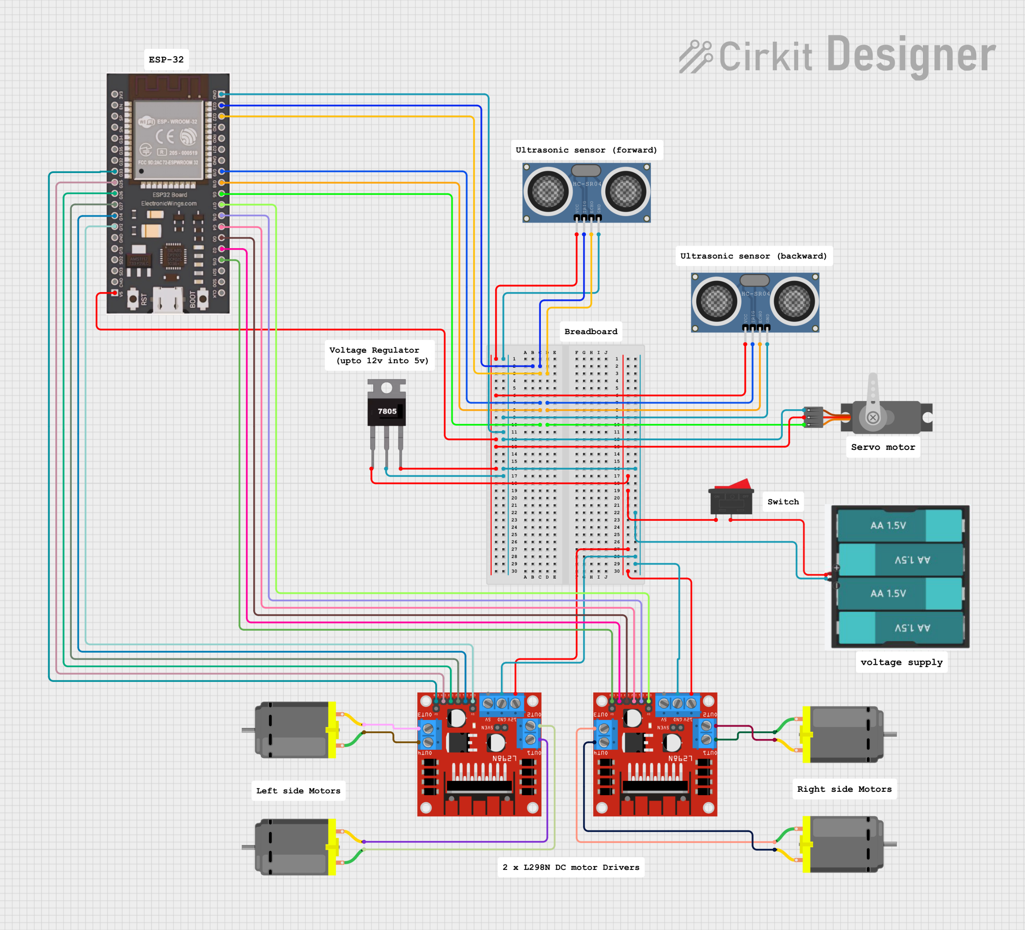
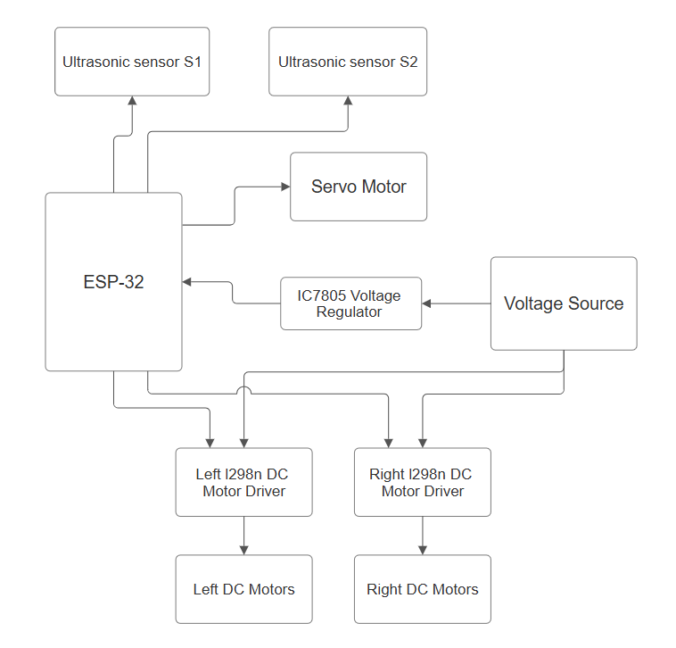
Circuit diagram
Block diagram
8

Slide 10
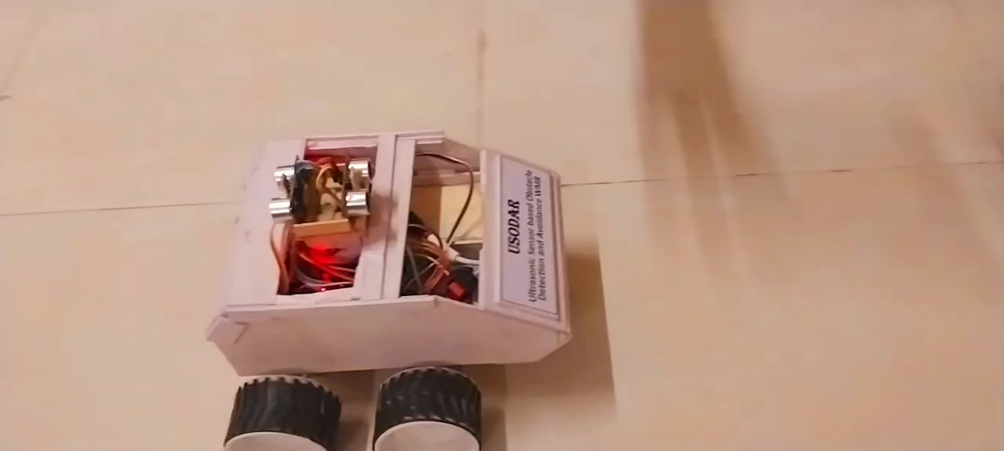

Slide 11
RESULT ANALYSIS
The robot consistently avoided obstacles across different floor surfaces during lab tests.
Dual ultrasonic sensors enabled smooth and reliable maneuvering around obstacles.
The L298N motor driver performed stably under varying load conditions.
Sensor readings remained accurate within the operational range, ensuring precise detection.
The design allowed for easy hardware maintenance and minimal downtime.
Stress tests confirmed the system's robustness and consistent obstacle avoidance.
The robot maintained stable movement with negligible directional drift.
Motor response to obstacle detection was prompt, with minimal system latency.
The project was completed within a cost-effective budget.
Repeated trials demonstrated reliable and consistent performance.
9

Slide 12
CONCLUSIONS & FUTURE SCOPES
A cost-effective and functional obstacle detection and avoidance robot was developed using ESP-32, ultrasonic sensors, and L298N motor drivers. The system demonstrated reliable performance in basic indoor navigation tasks under controlled conditions.
Future Enhancements:
Integrate additional sensors (e.g., IR, LIDAR) for improved environmental awareness.
Enable outdoor navigation using GPS for location-based movement.
Implement smartphone-based wireless control and real-time monitoring.
Develop AI-based algorithms for smarter obstacle handling and path planning.
Optimize power usage and extend battery life for longer operational duration.
PID algorithm and A-Star algorithm can be used for efficient pathfinding along with obstacle avoidance
10

Slide 13
THANK YOU
Any questions ?

